Slide 1

Objectives
In this session, you will learn to:
  Account for employer ESI contributions

Slide 2
Accounting for Employer ESI Contributions
ESI contribution:
  It refers to the amount payable to the corporation by the principal employer in respect of employees and comprises of the amount payable by the employee as well as the employer.
  The employer is required to calculate and remit ESI contributions comprising of employers' share plus employees' share on or before 21st of the subsequent month in respect of salaries of the related month.
  The principal employer should pay employer’s share of contribution at the rate of 4.75% in respect of every employee whether employed directly or through immediate employer.
  The employee’s share at the rate of 1.75% has to be recovered by making deduction from their wages for the respective salary or wages period.

Slide 3

Demo: Accounting for Employer ESI Contributions
Problem Statement:
  On 1st June 2009, the list of new joinees with their Salary details are displayed in the following figure.

Slide 4
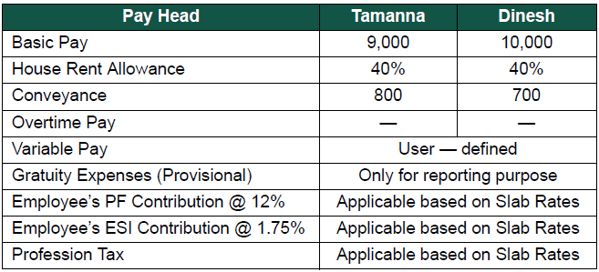
Demo: Accounting for Employer ESI Contributions (Contd.)
  The Salary details for the above new employees is listed, as shown in the following figure.

Slide 5
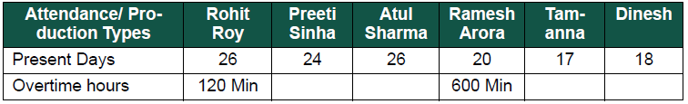
Demo: Accounting for Employer ESI Contributions (Contd.)
  The Attendance details for the month of June 2009 are given, as shown in the following figure.

Slide 6

Demo: Accounting for Employer ESI Contributions (Contd.)
Let us see how to account for employer ESI contributions in Tally.ERP 9.

Slide 7
Demo: Processing Employer ESI Contribution
Problem Statement:
  On 30th June, 2009 M/s. Indus Solutions Pvt. Ltd., processed Employer ESI Contribution for the month of June 2009.

Slide 8
Demo: Processing Employer ESI Contribution (Contd.)
Let us see how to process employer ESI contribution in Tally.ERP 9.

Slide 9
Payment of ESI
In Tally.ERP 9, once process for employee and employer contributions to employee’s state insurance is implemented, the total amount payable to ESIC comprising of employee’s contribution as well as employer’s contribution to ESI is accumulated separately in ESI payable ledger.

Slide 10
Demo: Processing Payment of ESI
Problem Statement:
  On 30th June, 2009 M/s. Indus Solutions Pvt. Ltd., processed the payment of ESI for the month of June 2009.

Slide 11
Demo: Processing Payment of ESI (Contd.)
Let us see how to process the payment of ESI in Tally.ERP 9.

Slide 12
Summary
In this session, you learned that:
  ESI contribution refers to the amount payable to the corporation by the principal employer in respect of employees and comprises of the amount payable by the employee as well as the employer.

